Slide 1
Computer Networks
Part I - Tutorial 2
Notes:
1

Slide 2
Question 1
A 64 kbps leased line connects two bank branches and is used for transferring secure bank information. A link layer protocol with 3-bit sequence number is deployed. Determine the minimum window size required to ensure that the throughput is at least 32 Kbps. Assume that the average packet size is 80 bytes, the signal propagation delay between the two sites is 10 ms, and the probability of error is negligible

Slide 3
Q1 answer
Given:
Tx_rate = 64 Kbps
Propagation delay (P_delay) = 10 millisecond
Packet size = 80 bytes = 640 bits
3 bit used for frame sequencing
Calculate Normalised propagation delay
a = Propagation delay /average frame transmission time
Ave frame tx_time = ave. frame size /Tx_rate
= 640 bit /64 K
= 10 msec.
a = 10 msec. /10 msec = 1

Slide 4
Q1 answer
The link utilisation for 32 Kbps is 32K/64K which is 0.5
Utilisation of the link is given by
U = N/(1 +2a) where N is the window size
0.5 ≤ N /( 1+ 2*1)
N ≥ 3/2 = 1.5
Round up the window size , i.e., 2 (< 2³=8)

Slide 5

Question 2
In the figure below, frames are generated at node A and sent to node C through node B. Determine the minimum transmission rate required between nodes B and C so that the buffers of node B are not flooded, based on the following:
(a) The data rate between A and B is 100 Kbps.
(b) The propagation delay is 10 μsec/km for both links.
(c) The lines are full duplex between the nodes.
(d) All data frames are 1000 bit long; ACK frames are separate frames of negligible length.
(e) Between A and B, a sliding-window protocol with a window size of 3 is used, and each frame is acknowledged individually.
(f) Between B and C, a stop and wait is used.
(g) There is no error, and the processing delay at the nodes is negligible.

Slide 6
Question 2: Transmission Rate Calculation
A B: Propagation Time = 2000 *10 μsec = 20 msec
Transmission Time = 1000/(100*10³) = 10 msec
B C: Propagation Time = 500 *10 μsec = 5 msec
Transmission Time = x = 1000/R msec
R = Data rate between B and C in kbps
A
B
Start sending 1st packet 00
Start sending 2nd packet 10
Start sending 3rd packet 20
Ack recd for 1st packet, start sending 4th packet 50
Ack recd for 2nd packet, start sending 5th packet 60
Ack recd for 3rd packet, start sending 6th packet 70
Ack recd for 4th packet, start sending 7th packet 100
Ack recd for 5th packet, start sending 8th packet 110

Slide 7
Question 2: Transmission Rate Calculation
A B: Takes 50 msec to transmit 3 frames.
B C: Takes 10 + x msec to transmit one frame
Therefore,
50 = 3 (10 + x) x = 20/3
x = 1000/R R = 1000/x = 150 kbps

Slide 8
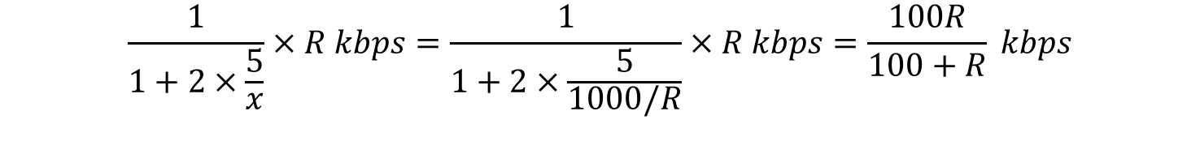

Another approach to solve this question
The required condition:
$$\frac{3}{5}×100 kbps≤\frac{1}{1+2×\frac{5}{x}}×R kbps$$
Because
$$\frac{3}{5}×100 kbps=60 kbps$$
and
$$\frac{1}{1+2×\frac{5}{x}}×R kbps=\frac{1}{1+2×\frac{5}{1000/R}}×R kbps=\frac{100R}{100+R} kbps$$
the required condition becomes
$$60 kbps≤\frac{100R}{100+R} kbps$$
which leads to
$$R ≥150 kbps.$$

Slide 9

Question 3
Consider a communication link between two cities of City S and City D. The frame transmission rate on the link is 100 kbps and the frame length is 25 bytes. The distance between City S and City D is 5 km and the propagation delay 3 ms/km. The communication link suffers from an average frame error probability of 0.2 and we adopt a Selective-Reject ARQ mechanism between City S and City D for reliable communication.
If the window size is 10, compute the link utilization from City S to City D.
Compute the minimum window size and the corresponding number of bits reserved for frame sequence in the header, in order to maximize the link utilization between City S and City D.

Slide 10


Q3(a): Selective-Reject ARQ Utilization
Frame transmission time
Propagation delay
Normalized propagation delay
Utilization of the ARQ

Slide 11

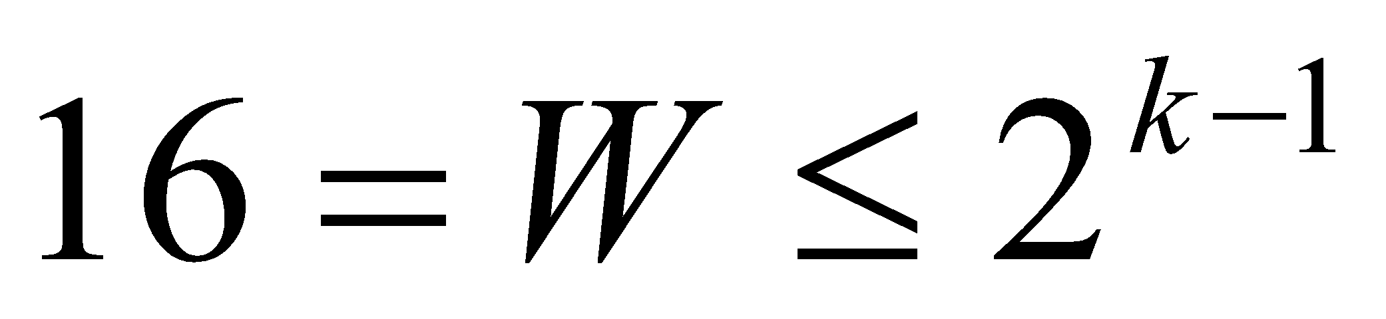
Q3(b): Minimum Window Size
Minimum window size to maximize the throughput is 16
In Select-Repeat ARQ, for a k-bit sequence, the maximum window size is
Therefore, the minimum number of bit for sequencing is 5

Slide 12
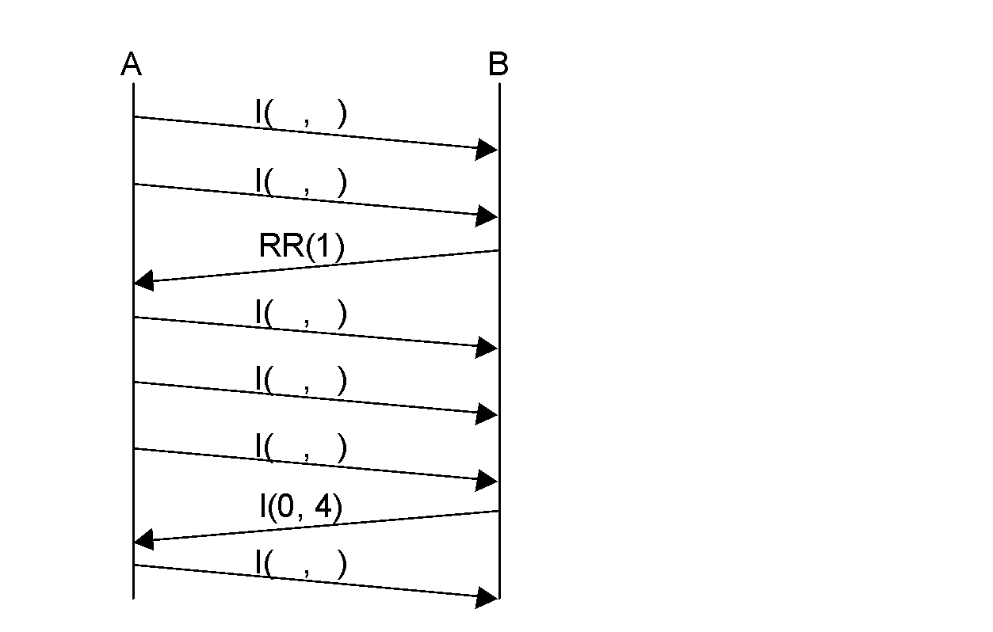
Question 4a: HDLC

Slide 13
Question 4(a)
A
B
A
B
A
B
I( , )
I( 7, )
I( 7,0 )
I( , )
I(0 , )
I(0 ,0 )
RR(1)
RR(1)
RR(1)
I( , )
I(1 , )
I(1 , 0)
I( , )
I( 2, )
I( 2,0 )
I( , )
I( 3, )
I( 3, 0)
I(0 , 4)
I(0 , 4)
I(0 , 4)
I( , )
I(4 , )
I(4 ,1 )

Slide 14
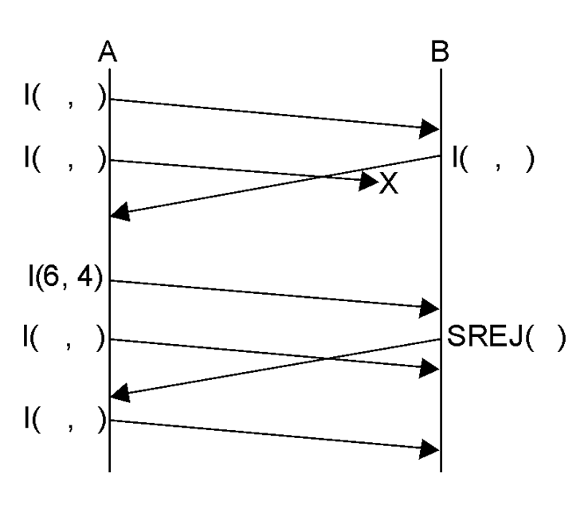
Question 4b: HDLC

Slide 15
Question 4(b)
A
B
A
B
A
B
I( , )
I(4 , )
I(4 , 3)
I( , )
I(5 , )
I(5 , 3)
I( , )
I( , 5)
I(3 , 5)
X
X
X
I( 6, 4)
I( 6, 4)
I( 6, 4)
I( , )
I(7 , )
I(7 , 4)
SREJ(5 )
SREJ(5 )
SREJ(5 )
I(5 , 4)

Slide 16
In addition to the office hours listed in Lecture Note 1, please feel free to contact Assistant Professor Jun ZHAO as follows to schedule appointments to ask questions. Thanks!
WhatsApp: http://personal.ntu.edu.sg/JunZhao/whatsapp.png
WeChat: https://personal.ntu.edu.sg/JunZhao/wechat.png
Singapore Phone Number (WhatsApp): 8648 3534
Email or Microsoft Teams: JunZhao@ntu.edu.sg
Skype ID: live:junzhaocmu
Office: Block N4, Room 02C-111, 50 Nanyang Ave, Singapore 639798
Homepage: http://personal.ntu.edu.sg/JunZhao/

